Slide 1

Exploration of 4 Different Income Levels: on Topics of Health and Poverty
Bekircan Kirkici
Fall 2019
INSY 6500 w/ Dr. Jeff Smith

Slide 2
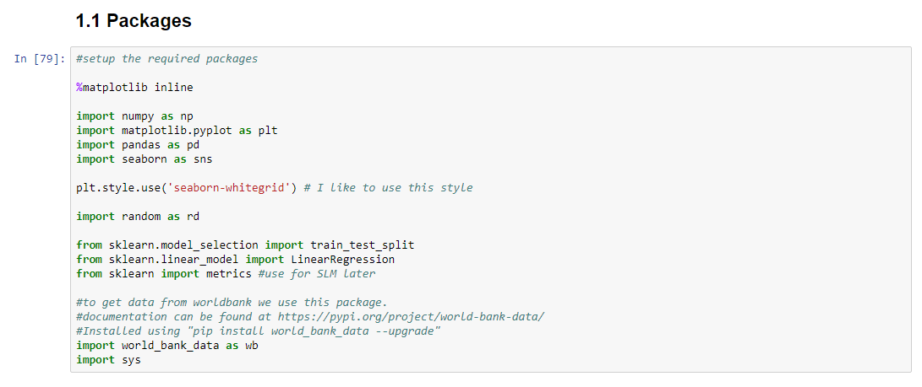
Outline
Initizaliztion
Packages and Tools
Intent
Tidying & Intro
Exploration
Health
Poverty
Conclusion

Slide 3
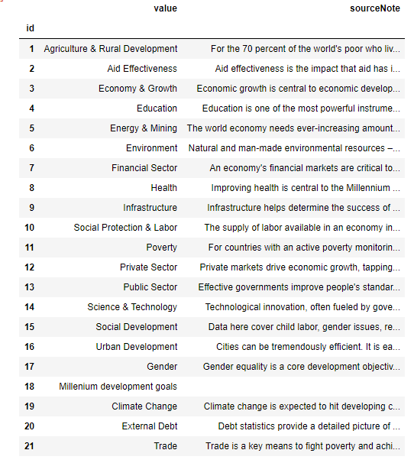
1) Initializtion
world_bank_data as wb
Topics, many, such as:
Education, growth, gender, debt, trade etc.
Sources
Both from WorldBank
Health and Poverty
Popular and most controversial

Slide 4
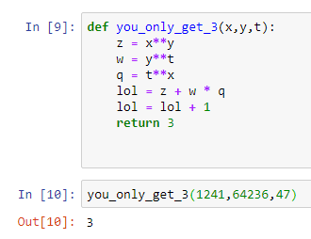
1) Initialization
Intent
Show similarities between different income level countries
Give some “economical” perspective
I will show you a lot of graphs
Remember: this is an informational study

Slide 5
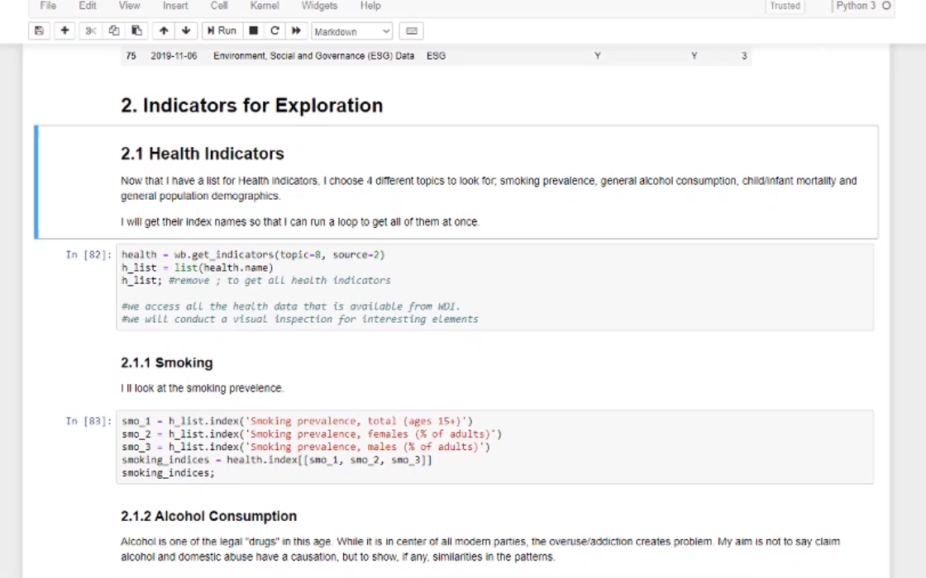
2) Tidying & Intro
Took a while
Most challenging part of my project
Still not fully tidied…
Have NaNs
5 Countries from 4 different income levels
Income levels generated by WorldBank

Slide 6
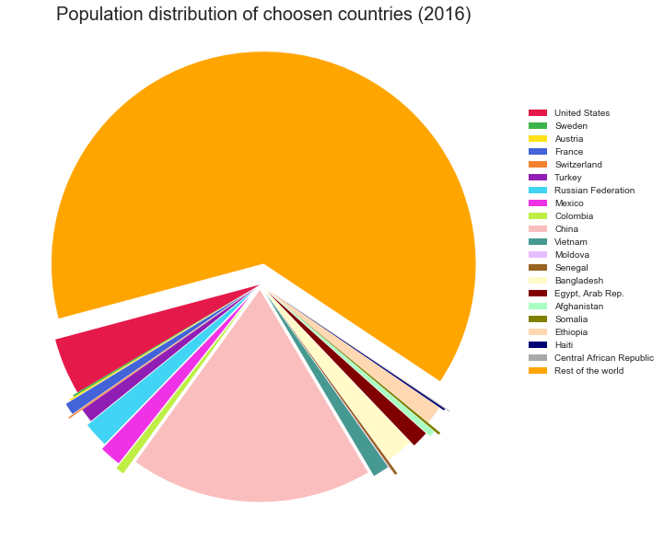
3) Exploration
Population distribution
Notice:
China
United States
Russia
Mexico

Slide 7
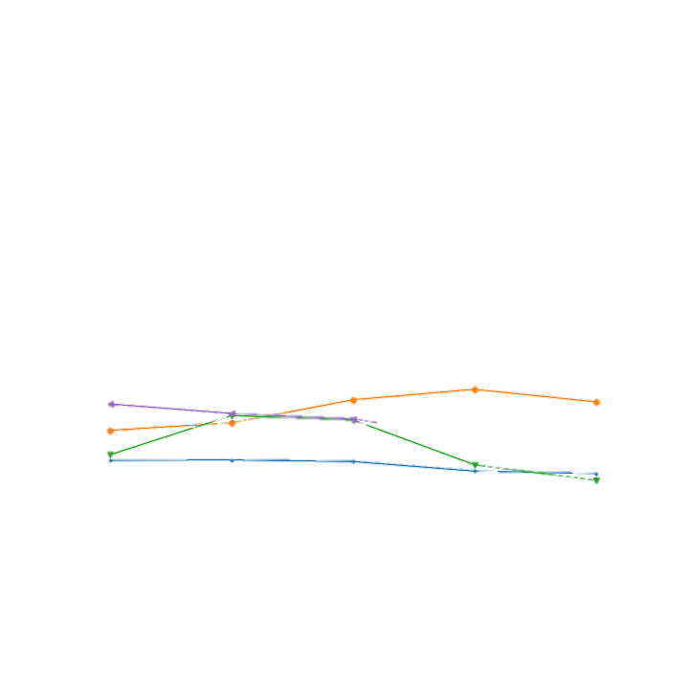
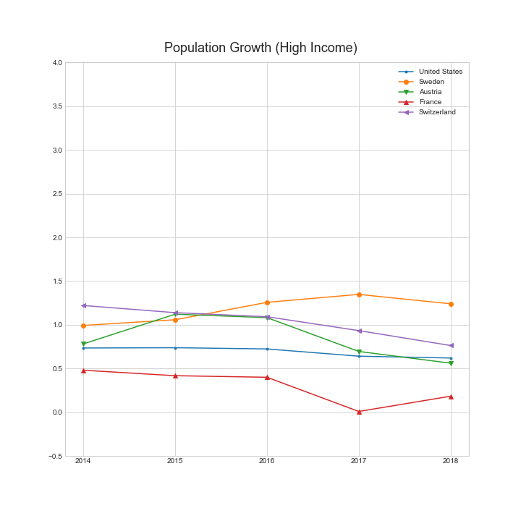
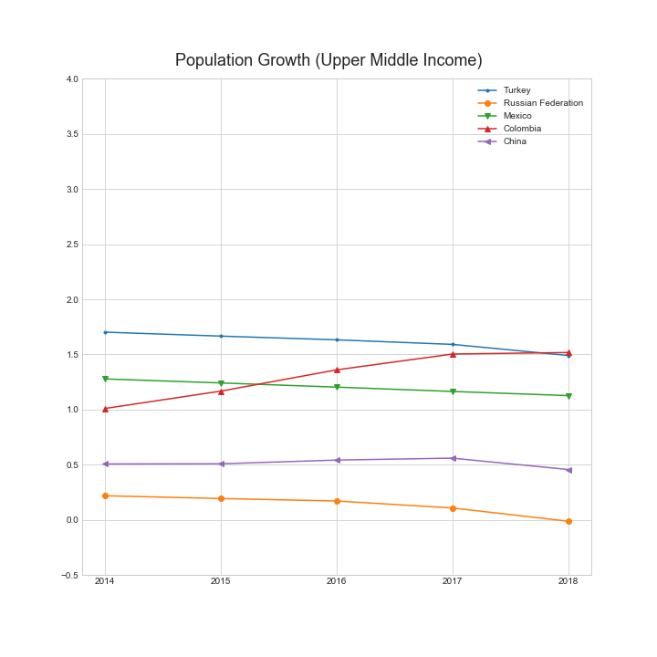
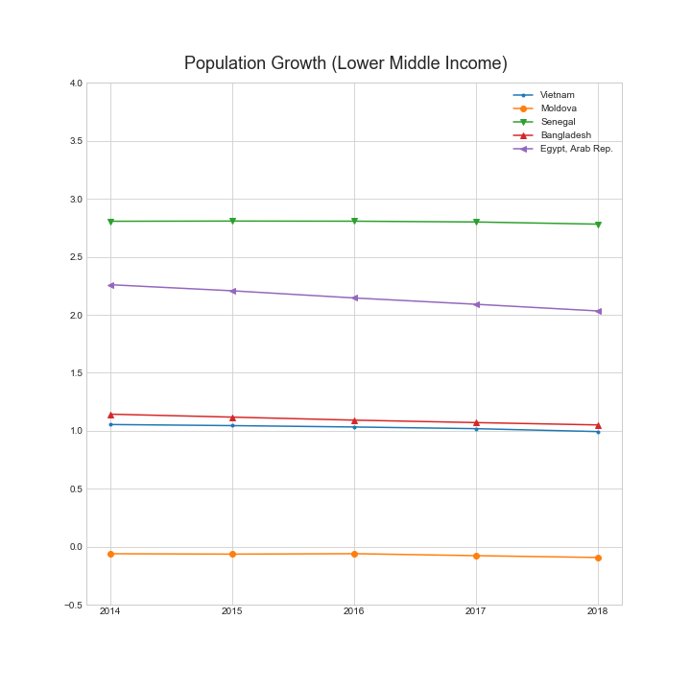
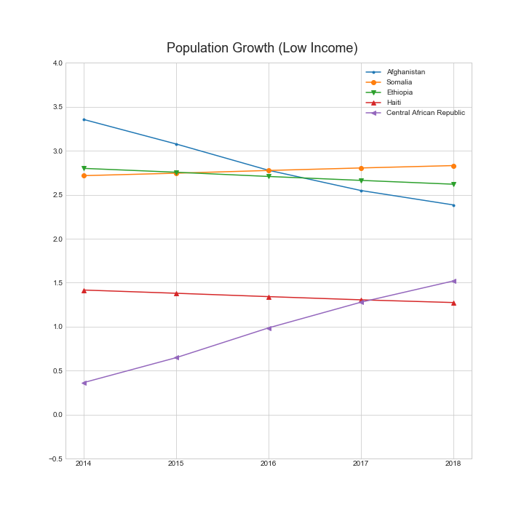
3) Exploration
Population growth
Notice:
Moldova

Slide 8
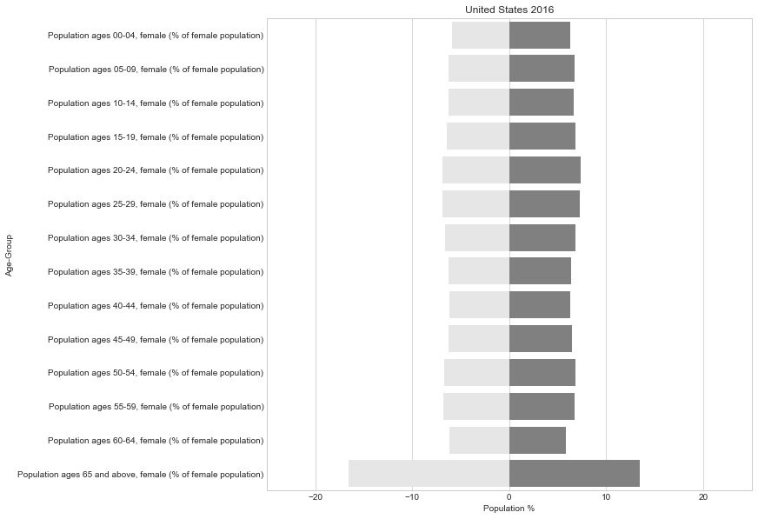
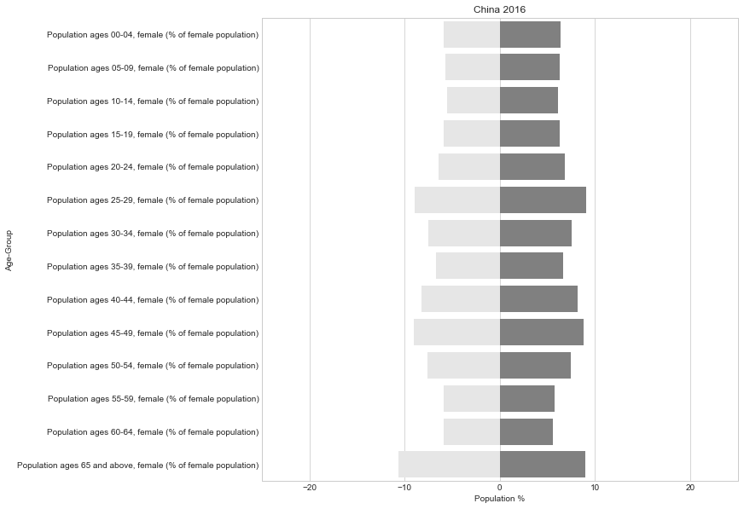
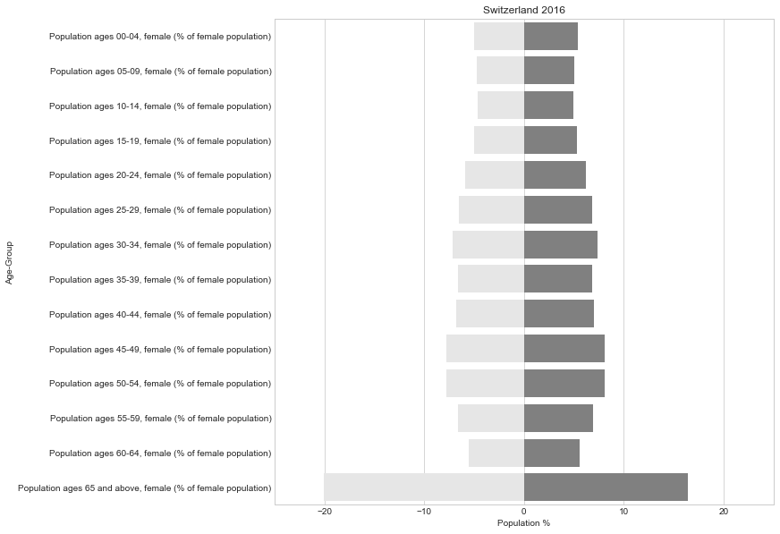
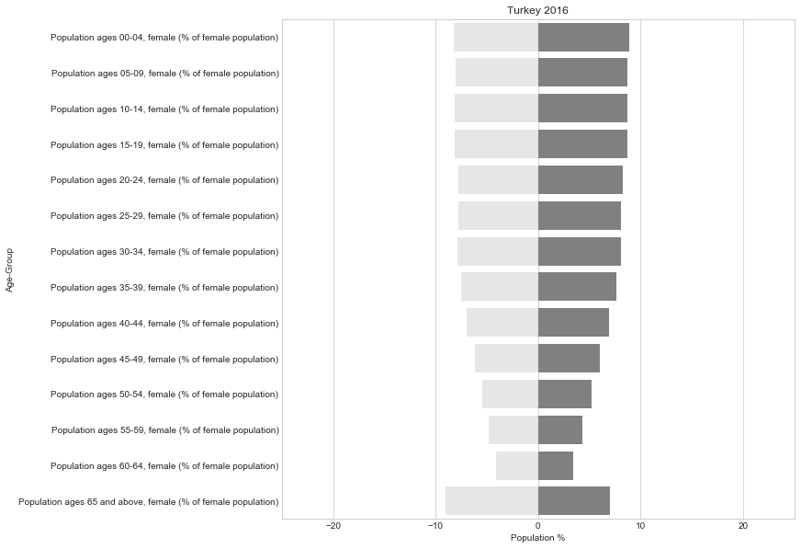
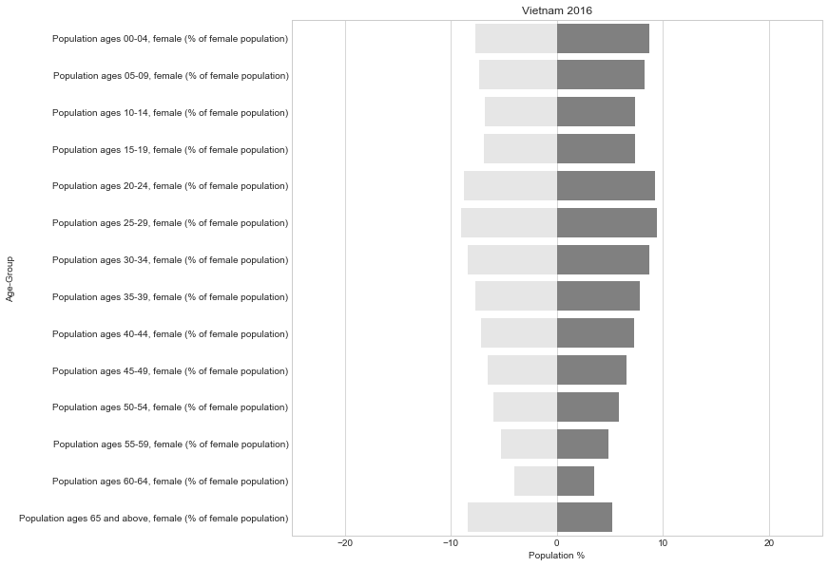
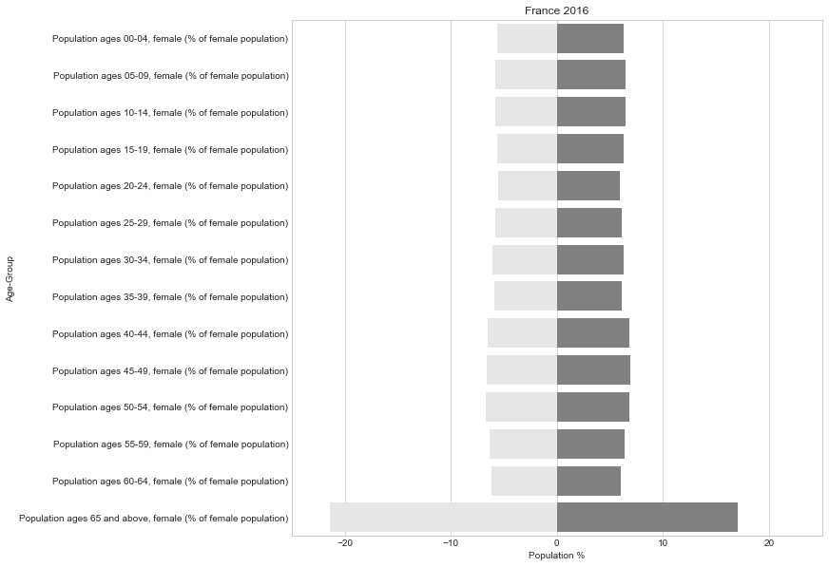
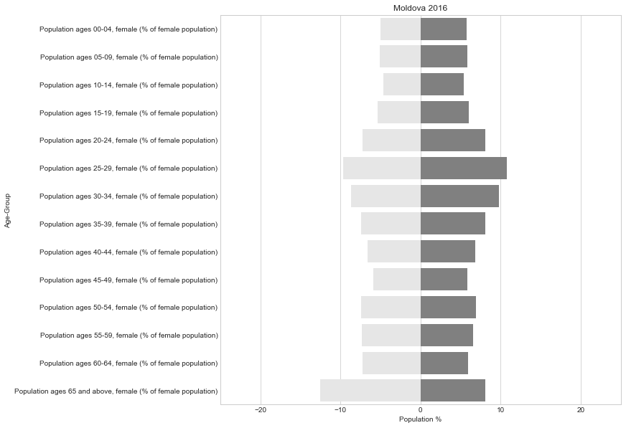
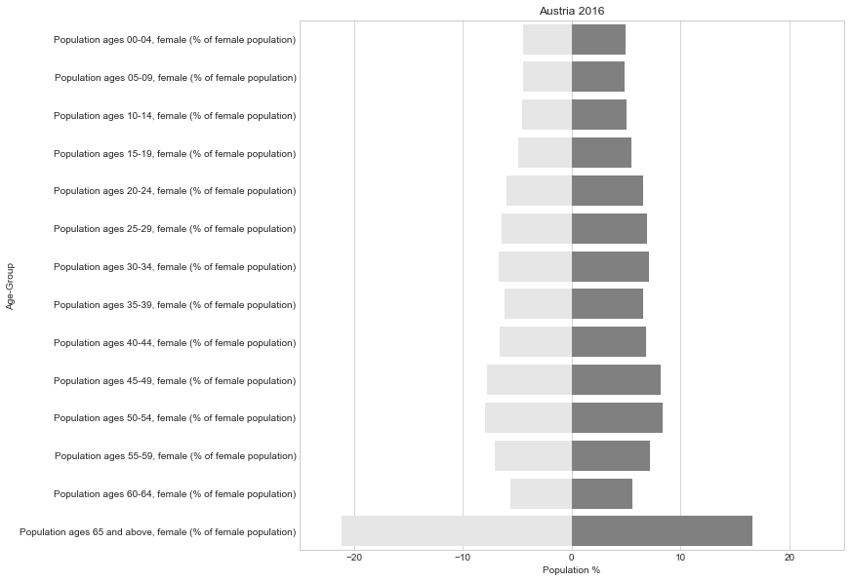
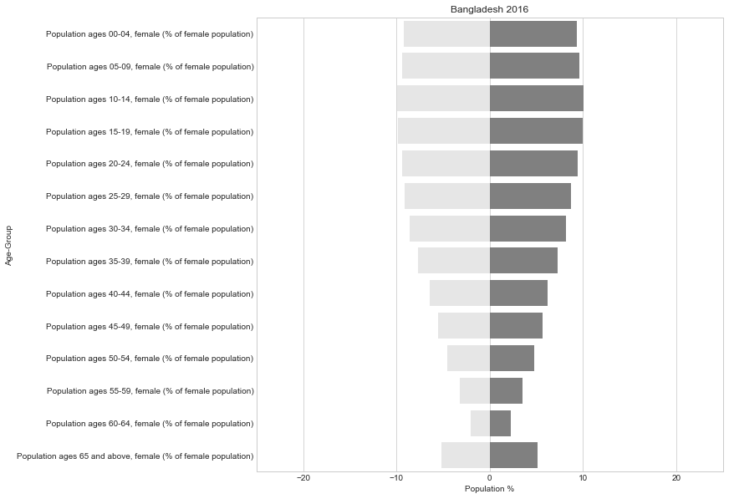
3) Exploration
Population pyramids
Notice:
High Income

Slide 9
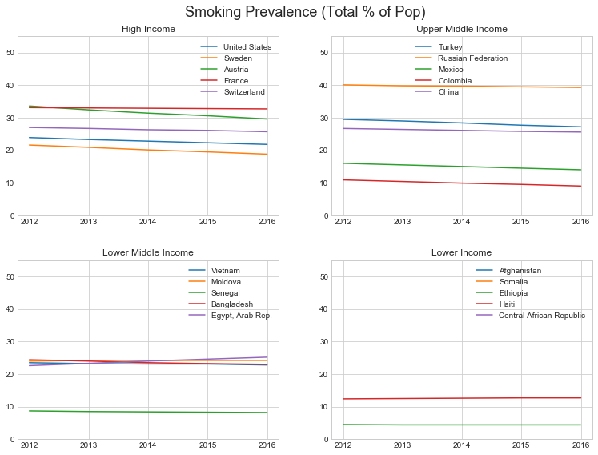
3) Exploration
Smoking prevalence
Notice
Upper Middle Income

Slide 10
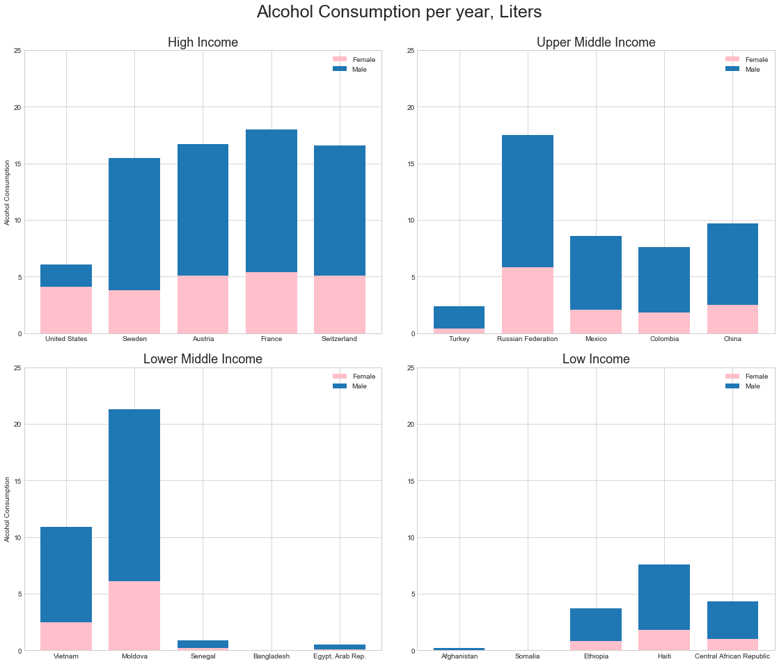
3) Exploration
Alcohol consumption
Notice
Low Income

Slide 11
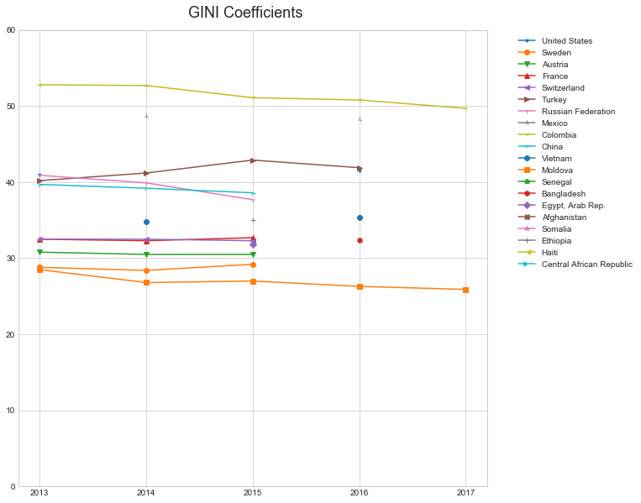
3) Exploration
GINI Index
Notice:
Highest 4
Columbia
Turkey
China
Russia

Slide 12
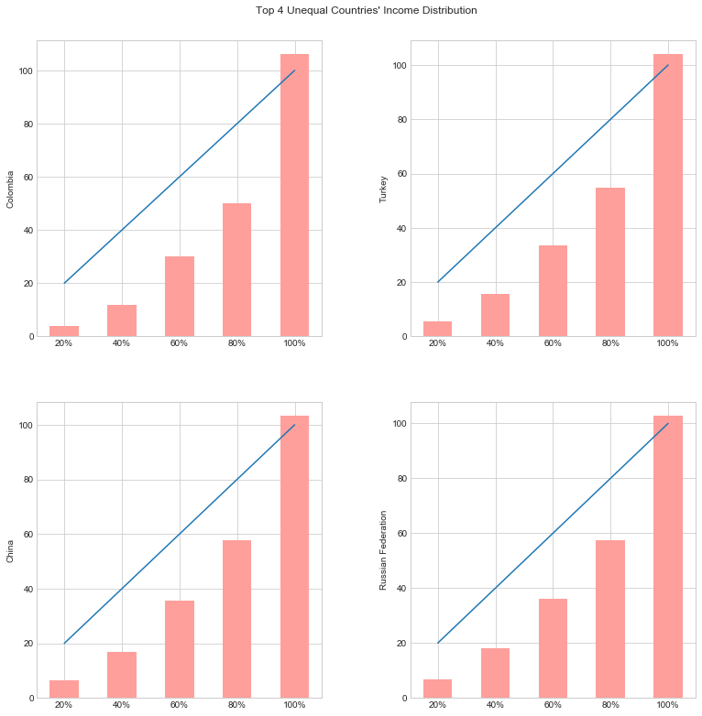
3) Exploration
Income distribution

Slide 13
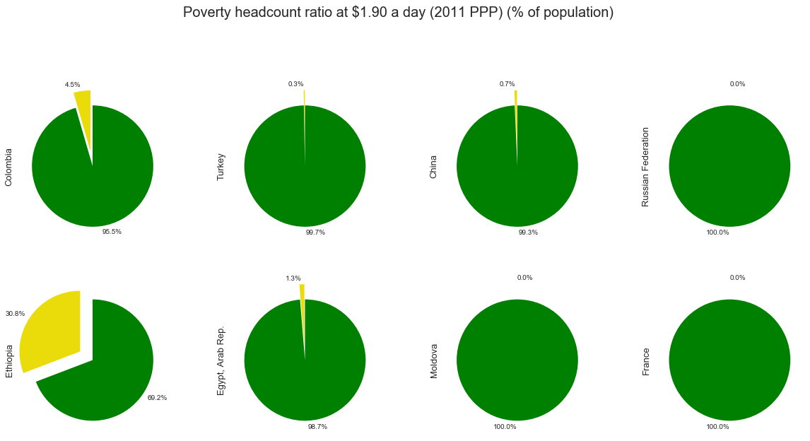
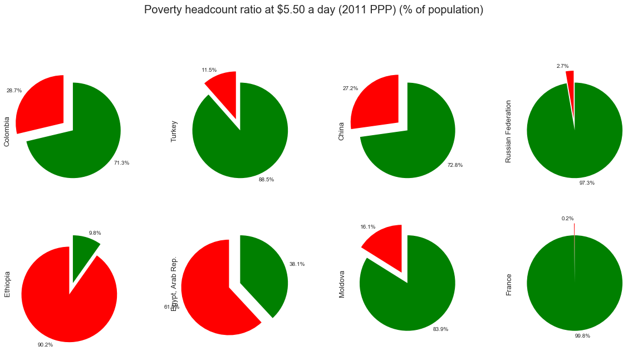
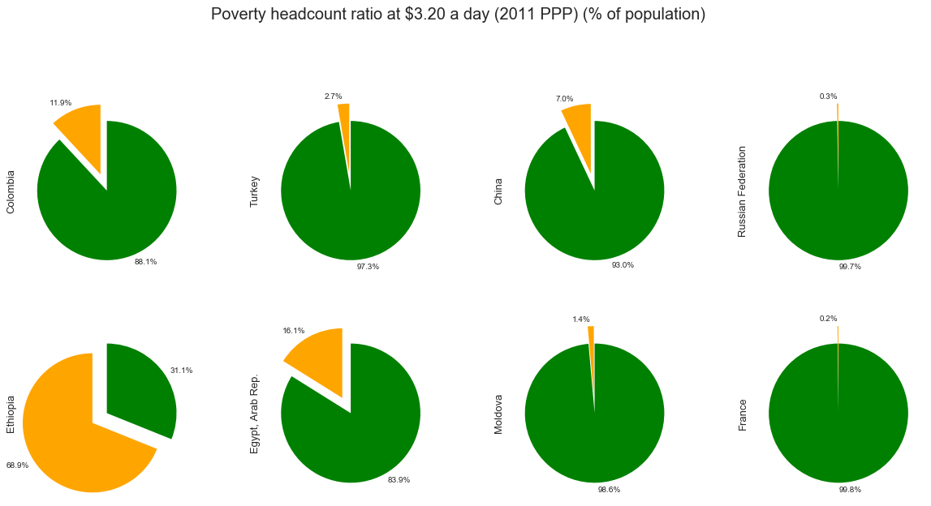
3) Exploration
3 Poverty lines

Slide 14
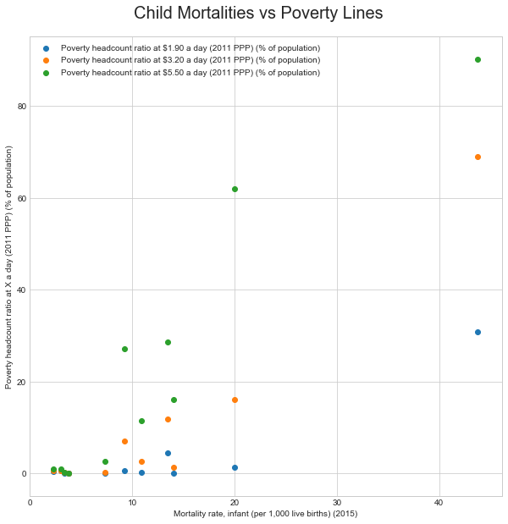
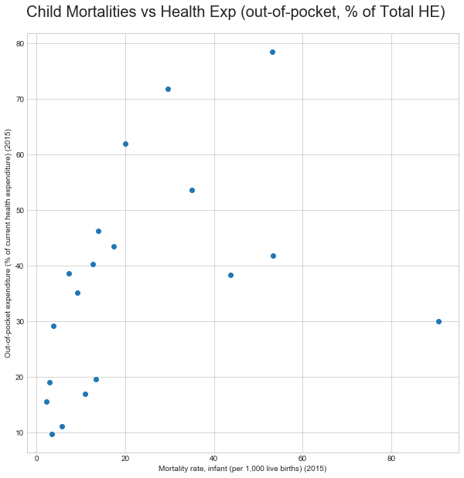
3) Exploration
Children

Slide 15
4) Conclusion
Hard to generalize different countries
Some “assumptions” can be challenged
Alcohol consumption vs smoking prevalence
Population dynamics in middle income countries
Income inequality in high income countries
Income distribution in lower middle to low income countries
Poverty vs health expenditures

Slide 16
Q & A
Please ask me if you have any questions.
Otherwise, have a great winter break!

